Slide 1
What Is an Agent?
From Classical AI to Modern Agentic Systems
DSC 360 Building AI-Powered Applications
Unit 7: LLM-Based Agents

Slide 2
Why This Topic Matters
“Agents” are one of the oldest ideas in AI.
LLM-based systems are bringing the concept back—with a twist.
Before we build one, we need a shared vocabulary.

Slide 3
Today’s Roadmap
Classical view: agents, environments, and rational action
How those ideas map onto LLM-powered applications
Looking ahead: adding an agentic loop to your Lab 6 pipeline
💡 An agent perceives, decides, and acts
Everything else—whether a robot, chatbot, or SQL pipeline—is a variation on that loop

Slide 4
Agents
Updated from R&N chapter 2

Slide 5
Agents and Environments: Classical View
How AI traditionally defined agents:
perception → decision → action
Rationality: choosing the best action by a performance measure
Environment: the world the agent acts in (real or digital)
👉 Note: We’ll use this vocabulary to describe our own systems today.

Slide 6
What Is an Agent? (classical AI)
Any system that perceives and acts in an environment
An agent …
Perceives its environment through inputs
    (e.g., text, data, sensor readings)
    → Percept = a single observation
    → Percept sequence = everything the agent has observed so far
Acts on the environment through outputs
    (e.g., SQL queries, API calls, messages)
    → Sometimes the best action is no action (safe refusal)

Slide 7
What Is an Agent? (our course)
Example:
Input: User’s natural-language request
Output: SQL statement, chatbot reply, or “insufficient context”
💡 Think of an agent as an “observe → decide → act” loop

Slide 8
How Agents Decide What to Do
Type | Description | Modern Analogue
Simple reflex | Reacts to current input only | Regex filter, rule-based chatbot
Model-based | Tracks state of world | Session memory, conversation context
Goal-based | Chooses actions to reach a goal | RAG answering a query
Utility-based | Weighs outcomes | Re-rankers, reward-tuned LLMs
Learning agent | Improves over time | Fine-tuning, self-critique loop

Slide 9
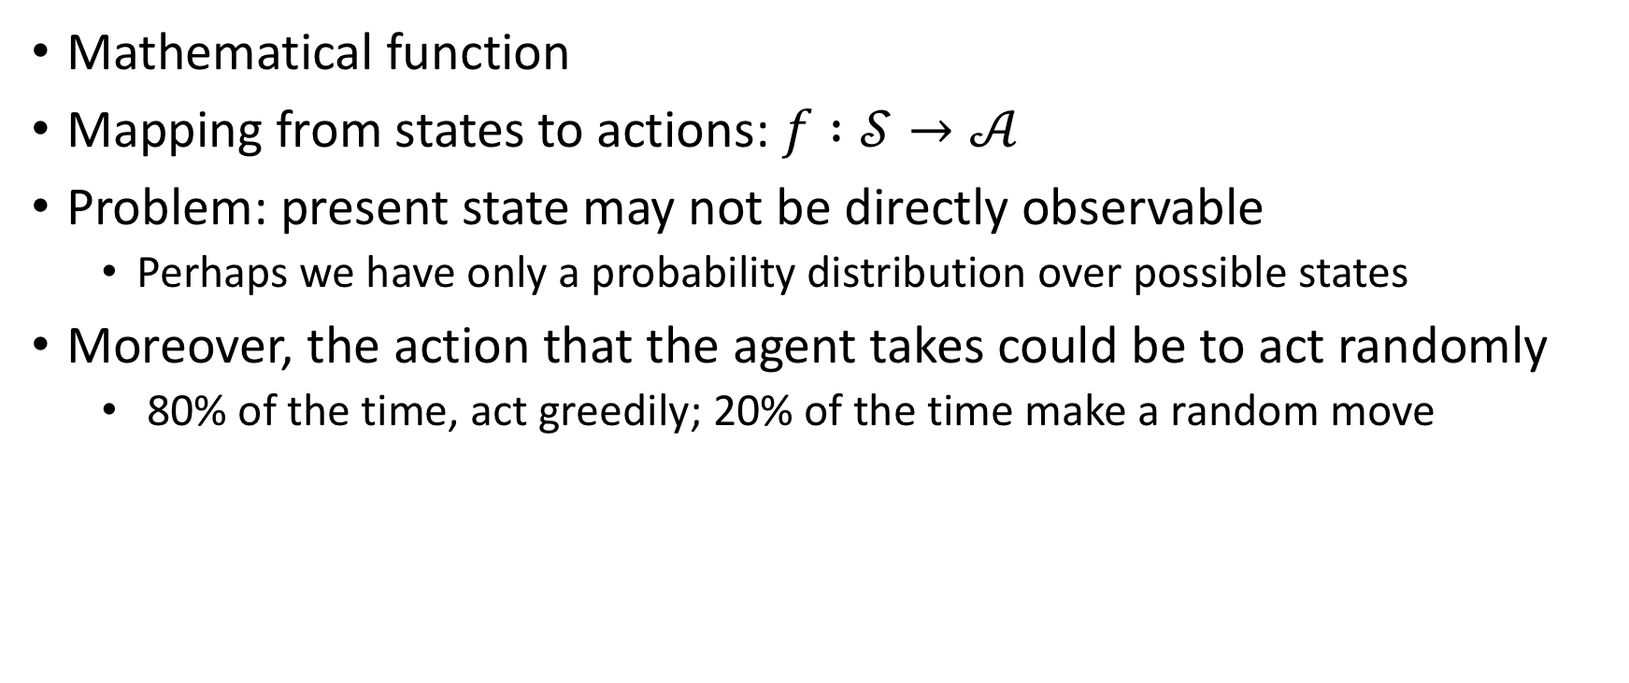
Agent Function
Mathematical function
Mapping from states to actions: $f :𝒮→𝒜$
Problem: present state may not be directly observable
  Perhaps we have only a probability distribution over possible states
Moreover, the action that the agent takes could be to act randomly
  80% of the time, act greedily; 20% of the time make a random move

Slide 10
What is a rational agent?
Definition: A rational agent acts so as
to maximize expected value of performance measure
given percept sequence it has seen so far
and whatever built-in knowledge it has
given realtime computational and explorational constraints.

Slide 11
Rationality definition
Rational ≠ Perfect — Why Agents Learn
Rational agents act under limited knowledge and compute time
They gather information to improve future actions
Autonomy = learning to compensate for gaps in prior knowledge.
  Dung beetle → follows rule without understanding
  Rational agent adapts

Slide 12
Environments
Task environments
The “problem” for which rational agents are the “solution”

Slide 13
Environments
The task environment specification includes:
[E] external environment itself
[S] sensors
[A] actuators
[P] the performance measure
The text suggests (permuting these and) using the
mnemonic acronym PEAS

Slide 14
Defining an Agent’s Task Environment (PEAS)
System | Performance | Environment | Actuators | Sensors
Roomba | Clean floor | Apartment | Motors | Dirt sensors
NL→SQL Pipeline | Correct & safe query | Database | SQL string | User input & results
LLM Tutor | Helpful response | Chat interface | Text output | Student message

Slide 15
Task environment dimensions
(simpler) | (more complex)
Fully observable | Partially observable
Single-agent | Multi-agent
Deterministic | Stochastic
Episodic | Sequential
Static | Dynamic
Discrete | Continuous
Known | Unknown

Slide 16
From Rational Action to Agentic Loops

Slide 17
From Classical Agents → LLM Agents
R&N Concept | Modern Equivalent
Sensors | Inputs – user text, retrieved docs, query results
Actuators | Function calls, SQL execution, file writes
Environment | Digital workspace (DBs, APIs, files)
Performance measure | Accuracy, safety, latency
Learning | Prompt tuning, feedback loops
R&N’s theory still fits—our “environment” is just digital

Slide 18
Key Takeaways
An agent perceives its environment, decides, and acts
Rationality ≠ perfection
  It means acting to maximize performance given what the agent knows
Every LLM-powered tool you’ve built so far fits this pattern in miniature:
  Chatbot
  Classifier
  NL→SQL pipeline
Adding feedback, memory, planning turns these into agentic systems.

Slide 19
Looking Ahead
Lab 6: Safe NL → SQL pipeline — a non-agentic system
Lab 7: Extend with agentic loop that reasons, tests, and improves
Keep thinking: What counts as a rational action for your application?
Classical AI gave us the theory of agents
Now, with modern AI, we are starting to build them

Slide 20
Questions?
Any lingering questions about agents and their environments?

Slide 21
Lab 6
Continue working on Lab 6: Building a Safe NL→SQL Pipeline
Looking Ahead: Lab 7 will extend Lab 6 with a simple Agentic Loop

